Slide 2
Successful computer game designer who said, “The fundamental motivation for all game playing is to learn.”
http://www-rohan.sdsu.edu/~stewart/cs583/ACGD_ArtComputerGameDesign_ChrisCrawford_1982.pdf

Slide 3
Simple vs. complex games
Points out higher-order thinking, problem solving, collaboration that complex games require
Digital natives vs. digital immigrants

Slide 4
Famous instructional designer who believes that games are the best way to teach everything.
http://www.thiagi.com/

Slide 5
There’s a multimedia effect: lessons that incorporate multiple media types (text, images, sounds, animations, video, etc.) result in better learning.
Better learning: long-term memory, transfer knowledge to other situations, etc.

Slide 11
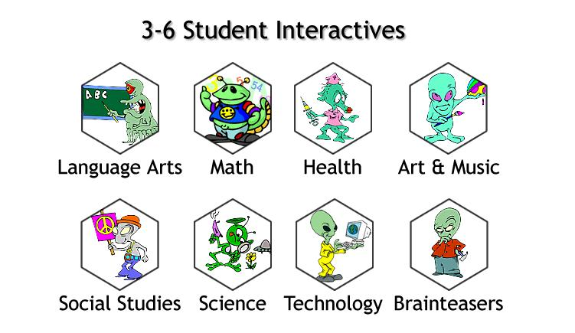

Slide 16
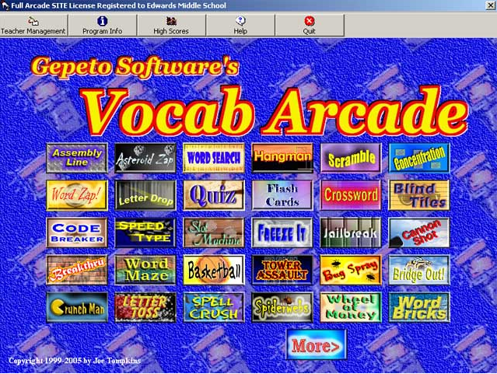

Slide 18
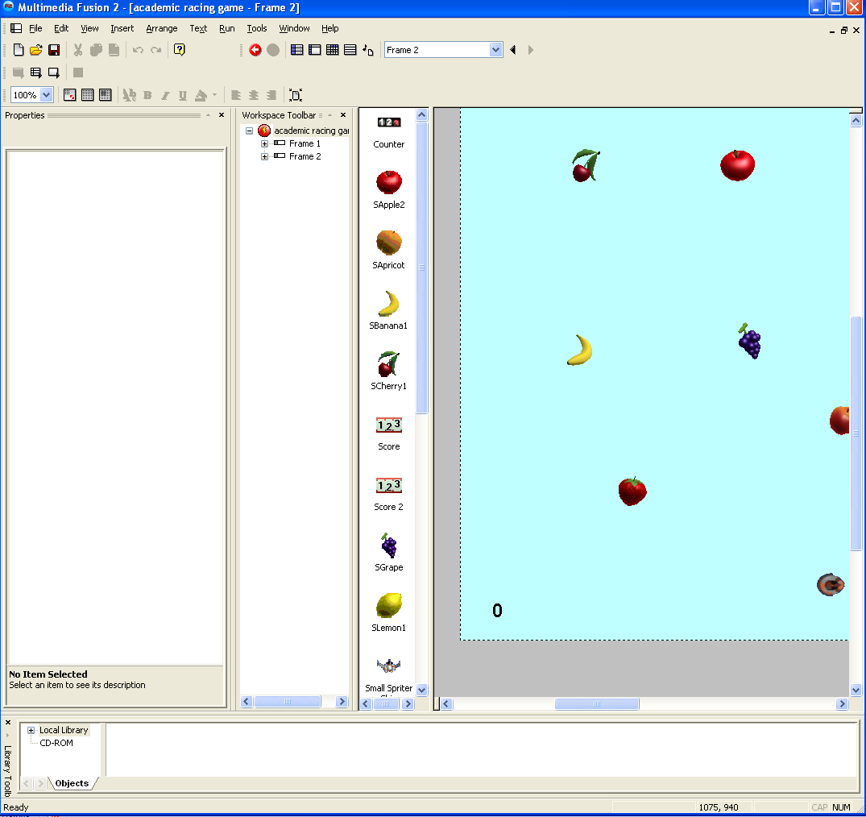

Slide 19
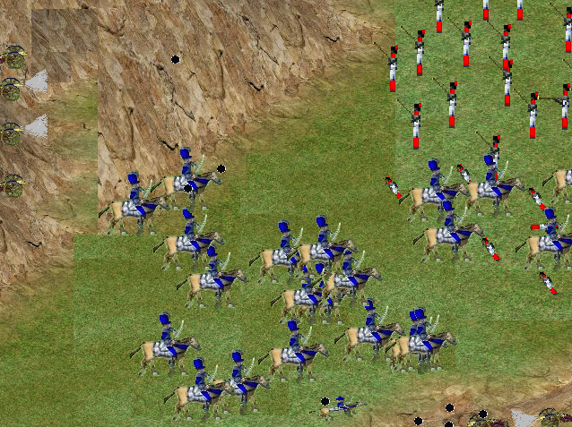

Slide 21
Goals
Feedback
Conflict/Competition/Challenge/Opposition
Interactions (with computer and people)
Lower the consequences of failure
Give students choices
Stay within, but at the outer edge, of the students’ “zone of proximal development”
Concept of “leveling up”
Digital Game-Based Learning (McGraw-Hill 2000) – Marc Prenski

